Slide 1
Genetic transfer and mapping in bacteria and bacteriophages
Chapter 6

Slide 2
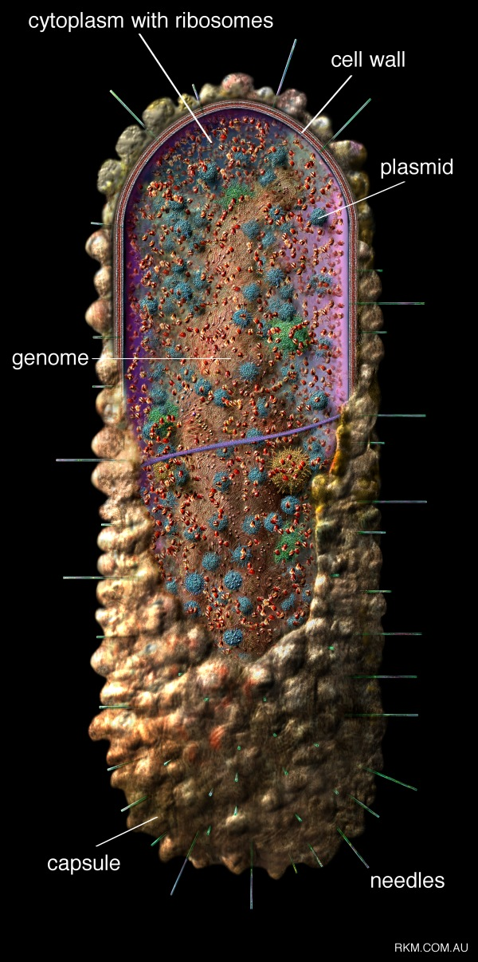

Slide 3
Bacterial uniqueness
Allelic changes can result in phenotypic differences
Can have loss of function mutations

Slide 4
Bacteria: differences from eukaryotes
Usually haploid for a gene
Loss of function is not masked by a second allele
Genetic experiments involve transferring genetic material (not setting up crosses- although they can be mated)
Three mechanisms for genetic transfer

Slide 5
Nobel Prize 2005
Drs. Warren and Marshall

Slide 6
H. pylori migration
Max Planck Institute for Infection Biology

Slide 7
Methods for bacterial growth

Slide 8
Bacterial Types
Prototrophic bacteria: strains that can grow in minimal media with only:
  Carbon, Nitrogen, phosphorus, vitamins, ions, nutrients
  ** Have genes required to MAKE everything else
Auxotrophic bacteria: lack one, multiple genes encoding enzymes required for synthesis of AA, nucleotides, substances not added to minimal media

Slide 9
Bacterial Genetic Nomenclature
wild-type – ‘+’
mutant gene – ‘-’
three lower case, italicized letters – a gene (e.g., leu+ is wild-type leucine gene)
The phenotype for a bacteria at a specific gene is written with a capital letter and no italics
  Leu+ is a bacteria that does not need leucine to grow
  Leu- is a bacteria that does need leucine to grow

Slide 10
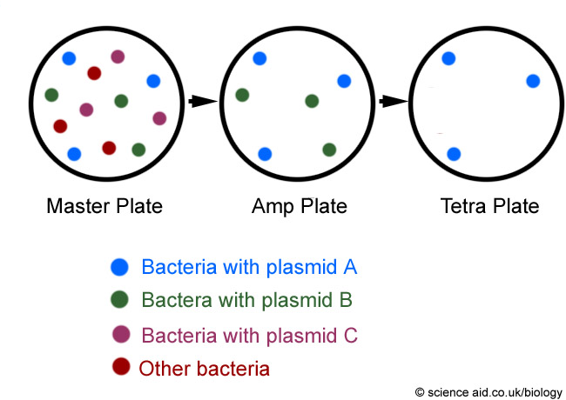
Replica Plating

Slide 11
Results of replica plating
Prototroph
Auxotroph
Prototroph
Auxotroph
Leu⁺
Trp⁺
Ade⁻
His⁻
Leu⁺
Trp⁺
Ade⁻
His⁻
WT
WT

Slide 12
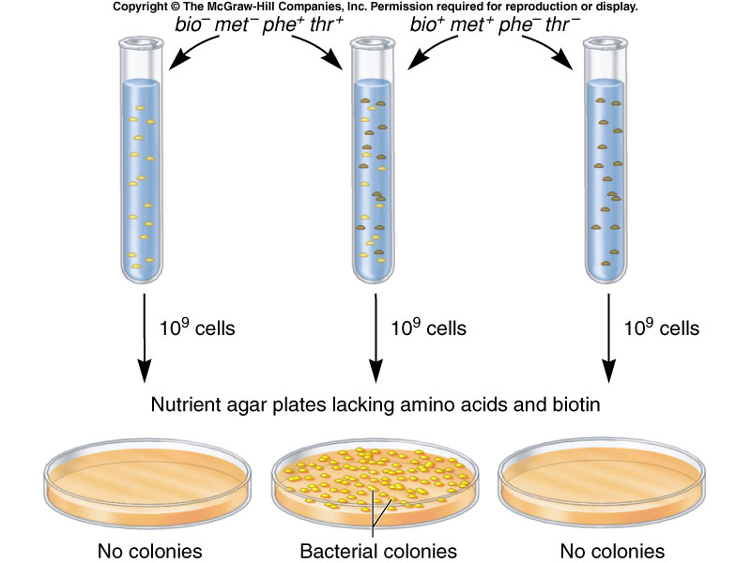
Observations of genetic transfer
Look at 2 strains that had opposing growth requirements
bio
met
phe
thr
Strain 1
Strain 2
+
-
+
-
-
+
-
+
When mixed- strains could grow on medial lacking all four additives

Slide 13
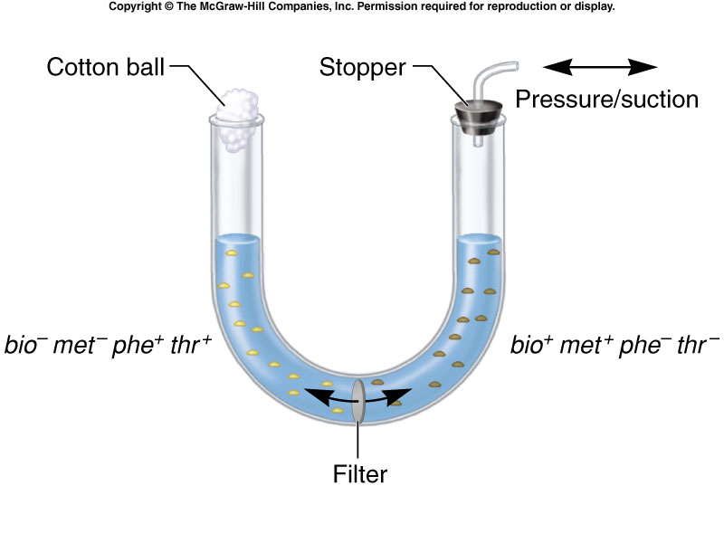
Transfer required physical contact

Slide 14
Mechanisms of DNA transfer
Conjugation
  Physical interaction between cells
Transduction
  Virus mediated transfer of DNA between bacteria
Transformation
  Requires release of DNA into environment, and the taking up of DNA by bacteria

Slide 15
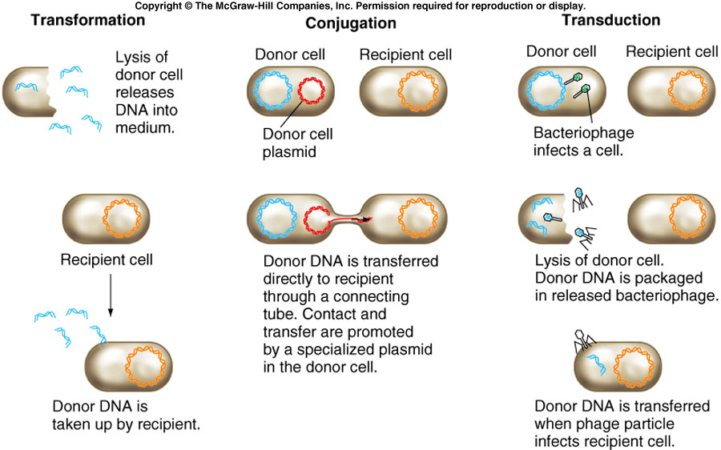
Mechanisms of bacterial gene transfer
McGraw Hill

Slide 16
Bacterial conjugation
Only specific bacteria can serve as donors (discovered by Lederbergs, Hayes and Cavelli-Sforza)
5% E. coli isolates are naturally a donor
Can be converted when incubated first with a donor strain
+
=
Donor +
Donor -
Donor+
Transfer of genetic material

Slide 17
Conjugation mechanism
Material called fertility factor (F factor), and is encoded on a plasmid (extrachomosomal DNA)
Strains called F⁺ or F⁻ to describe whether it harbors plasmid
Plasmids that are transmitted in this fashion: conjugative plasmids
  Have genes that code for proteins required for this transfer to occur

Slide 18
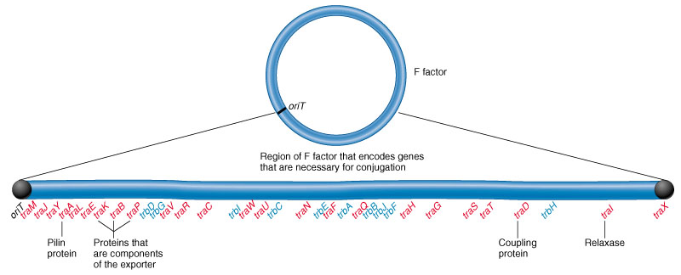
Conjugation apparatus
Sex pilus is made by donor strain
Physical contact is made between strains, pilus shortens, bringing bacteria closer
Contact initiates genetic transfer
Many genes on “F factor” required for transfer

Slide 19
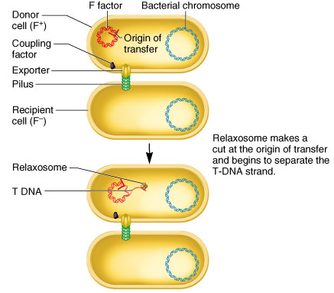
Mechanism of transfer
Relaxosome is produced
Relaxosome recognizes the origin of transfer
One DNA strand is cut and transferred over (T DNA)

Slide 20
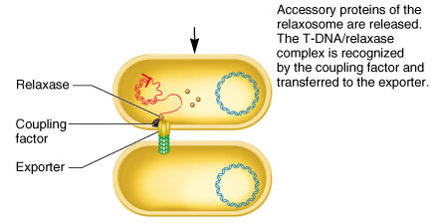
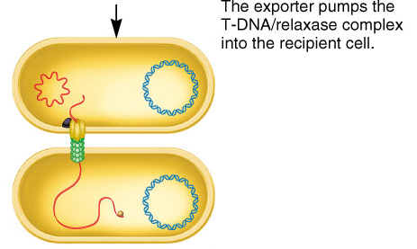
Mechanism of transfer
T DNA is separated, but bound to relaxase protein
Complex called nucleoprotein
Complex recognized by coupling factor, fed through exporter

Slide 21
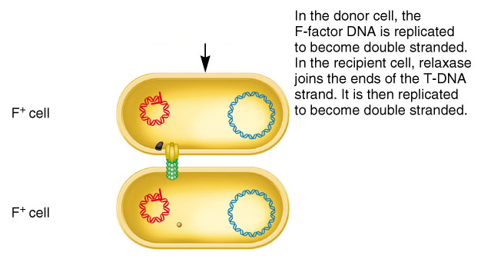
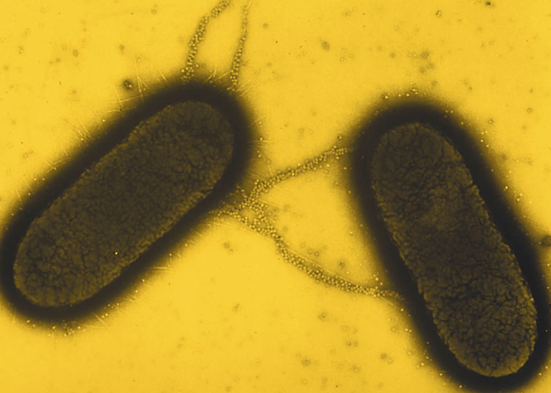
F factor transfer
Relaxase joins ends to produce circular molecule
Single strands of F factor are in both cells (DNA replication)

Slide 22
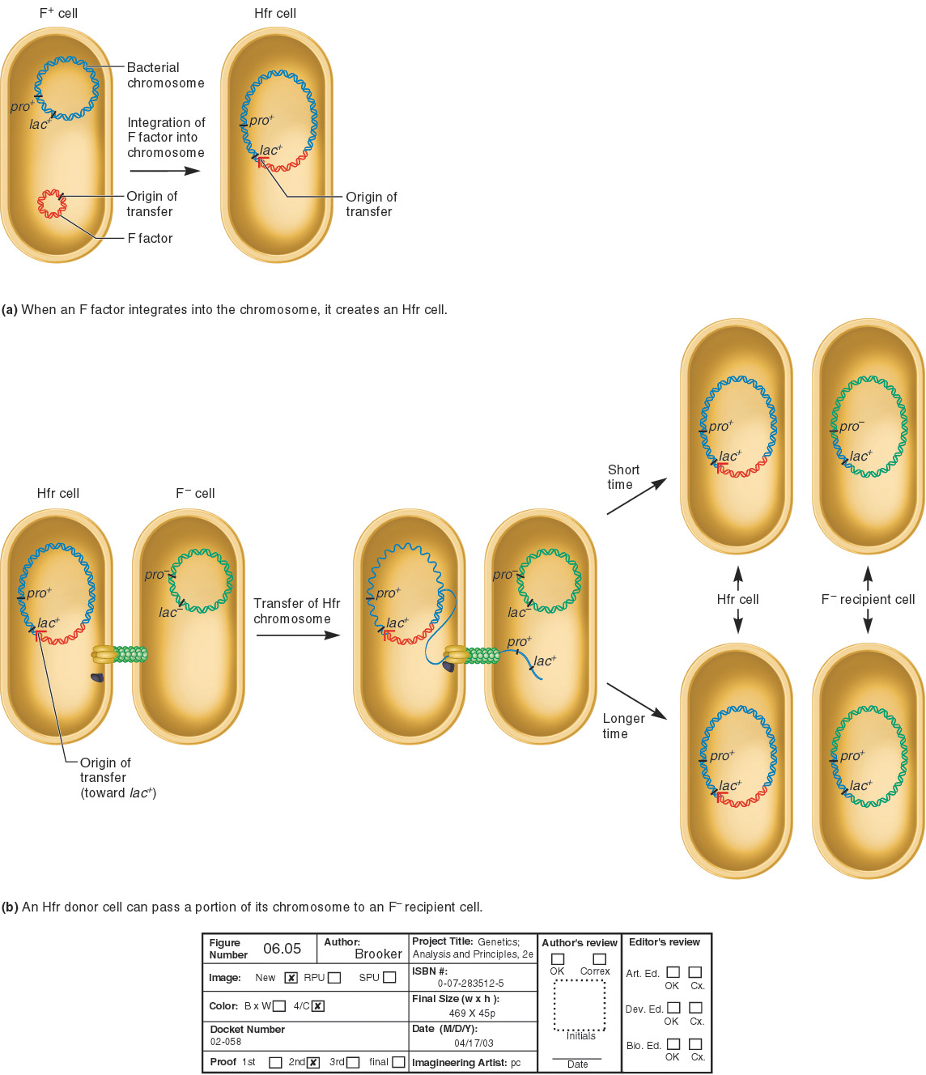
Integration of DNA into chromosome
Genes encoded on F factor can integrate into host DNA, and alter its genotype/phenotype
An Hfr strain was derived from an F⁺ strain
Episome:
DNA fragment that
can exist as a plasmid
and integrate into chromosome

Slide 23
Hfr strain
E. coli strain discovered as Hfr (high frequency of recombination)
Hfr strain transfers chromosomal DNA to F⁻ strains
This transfer begins at the origin of transfer
The amount of DNA transferred depends on the time of conjugation

Slide 24
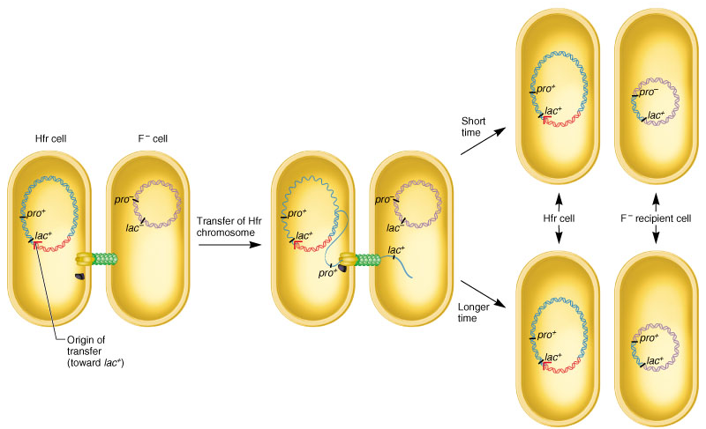
Hfr mediated conjugation
Pro: proline
Lac: lactose

Slide 25
Interrupted mating
The length of time a mating occurs, the more DNA is transferred
The Hfr DNA is transferred in a linear manner
By mating for different times, you can get DNA of several sizes, and determine the order of the genes, and how far apart they are (minutes)

Slide 26
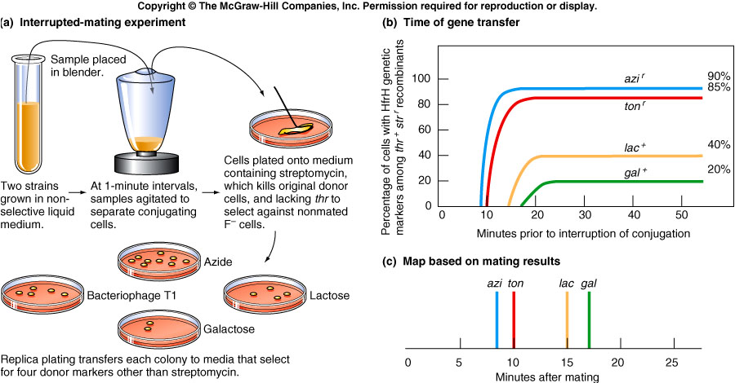
Mapping via Interrupted Mating

Slide 27
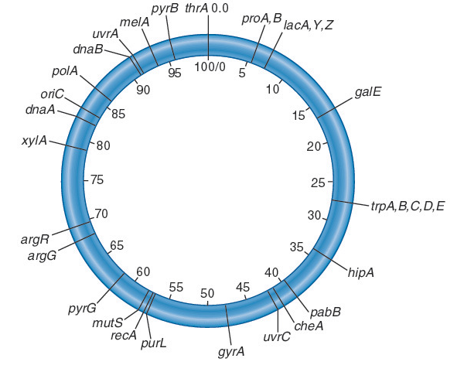
Mapping of the E. coli chromosome
This technique was utilized to map all genes of E. coli chromosome
100 minutes long (how long it takes to transfer over the entire chromosome)
Copyright ©The McGraw-Hill Companies, Inc. Permission required for reproduction or display

Slide 28
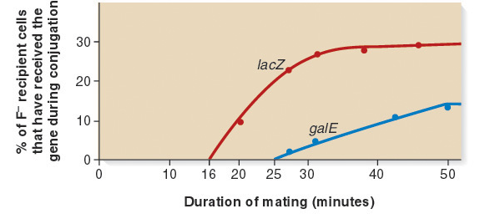
Mapping procedure
Genetic distance is determined by comparing their times of entry during an interrupted mating experiment
Therefore these two genes are approximately 9 minutes apart along the E. coli chromosome
Copyright ©The McGraw-Hill Companies, Inc. Permission required for reproduction or display

Slide 29
Transformation
Transformation is the process by which a bacterium will take up extracellular DNA
It was discovered by Frederick Griffith in 1928 while working with strains of Streptococcus pneumoniae
There are two types
  Natural transformation
    DNA uptake occurs without outside help
  Artificial transformation
    DNA uptake occurs with the help of special techniques

Slide 30
Natural Transformation
Bacterial cells able to take up DNA are termed competent cells
  They carry genes that encode proteins called competence factors
    These proteins facilitate the binding, uptake and subsequent corporation of the DNA into the bacterial chromosome

Slide 31
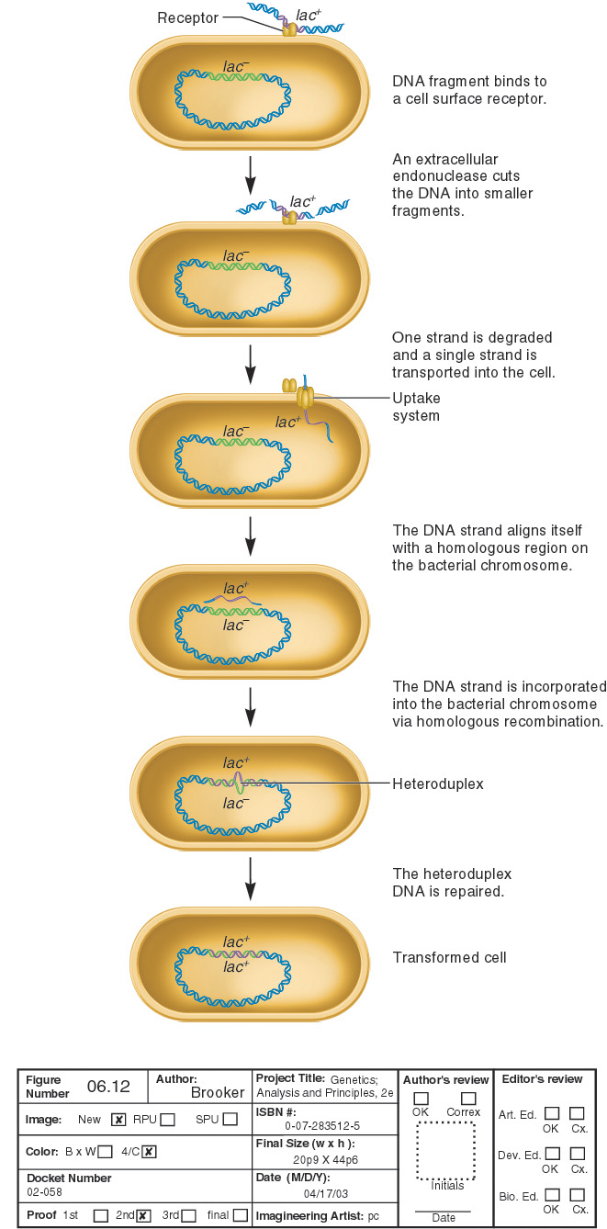
Natural transformation
A region of mismatch
By DNA repair enzymes

Slide 32
Non-homologous recombination
Sometimes, the DNA that enters the cell is not homologous to any genes on the chromosome
  It may be incorporated at a random site on the chromosome
Like cotransduction, transformation mapping is used for genes that are relatively close together

Slide 33
Gene transfer
Horizontal gene transfer is the transfer of genes between two different species
Vertical gene transfer is the transfer of genes from mother to daughter cell or from parents to offspring
A sizable fraction of bacterial genes are derived from horizontal gene transfer
  Roughly 17% of E. coli and S. typhimurium genes during the past 100 million years

Slide 34
Horizontal Gene transfer
The types of genes acquired through horizontal gene transfer are quite varied and include
  Genes that confer the ability to cause disease
  Genes that confer antibiotic resistance
Horizontal gene transfer has dramatically contributed to the phenomenon of acquired antibiotic resistance
  Bacterial resistance to antibiotics is a serious problem worldwide
    In many countries, nearly 50% of Streptococcus pneumoniae strains are resistant to penicillin

Slide 35
Virally encoded genes
Viruses are not living
  However, they have unique biological structures and functions, and therefore have traits
Focus on bacteriophage T4
  Its genetic material contains several dozen genes
    These genes encode a variety of proteins needed for the viral cycle

Slide 36
Transduction
Transduction is the transfer of DNA from one bacterium to another via a bacteriophage
A bacteriophage is a virus that specifically attacks bacterial cells
  Composed of genetic material surrounded by a protein coat
  Bacteriophage have 2 life cycles
    Lytic
    Lysogenic

Slide 37
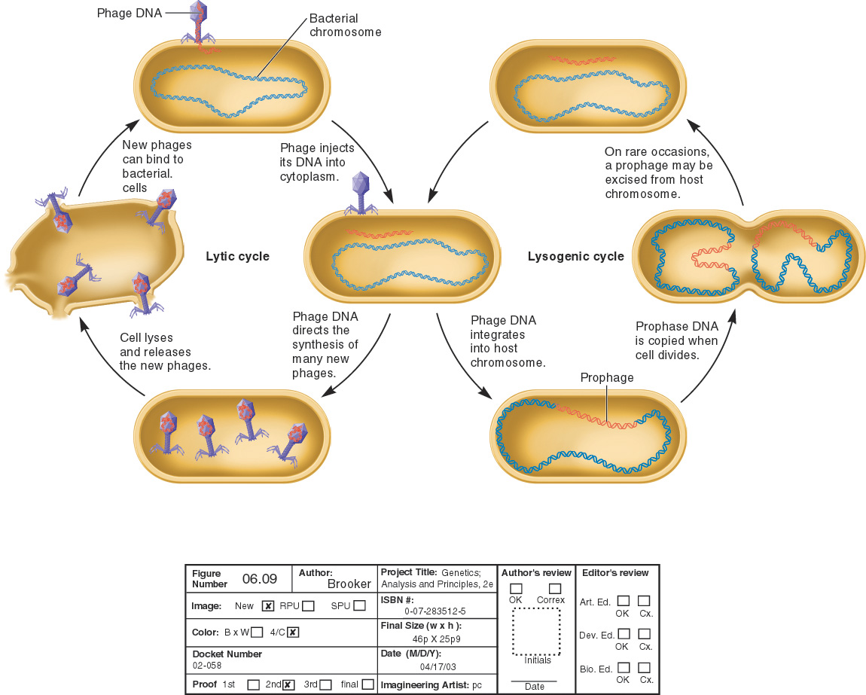
Life cycles of bacteriophage
It will undergo the lytic cycle
Prophage can exist in a dormant state for a long time
Virulent phages only undergo a lytic cycle
Temperate phages can follow both cycles
Copyright ©The McGraw-Hill Companies, Inc. Permission required for reproduction or display

Slide 38
Types of transduction
Generalized
  Produce some phage particles with DNA only from host origin, from any part of chromosome (P22)
Specialized
  Produced particles with both phage and host DNA, linked in a single DNA molecule, from a specific region of the chromosome (E. coli phage λ)

Slide 39
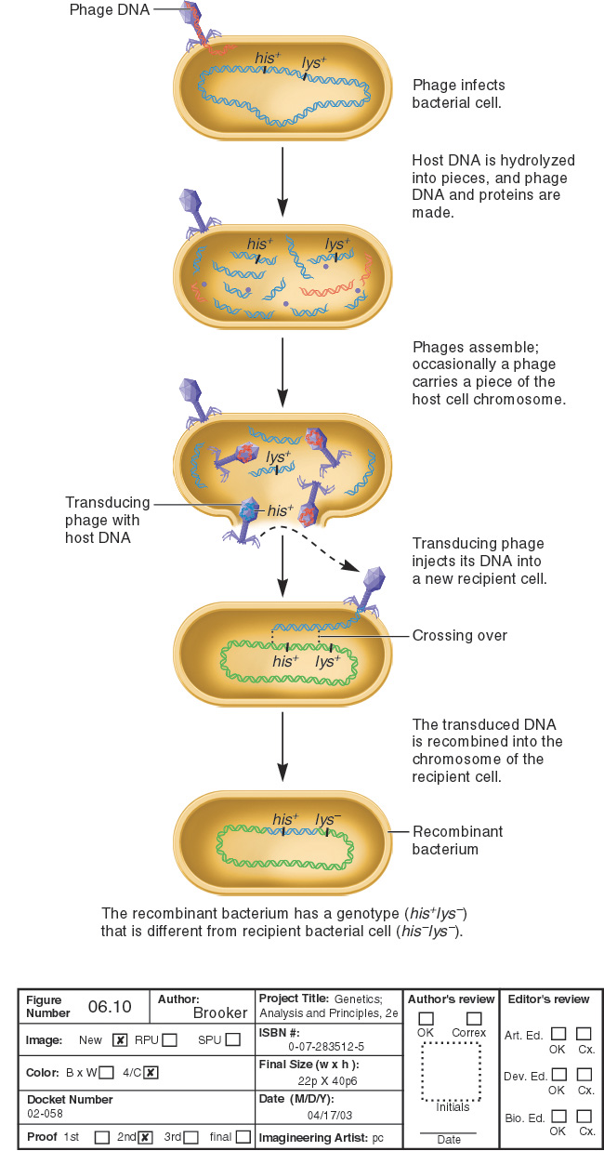
Generalized transduction
Phages that can transfer bacterial DNA include
  P22, which infects Salmonella typhimurium
  P1, which infects Escherichia coli
Temperate
phages

Slide 40
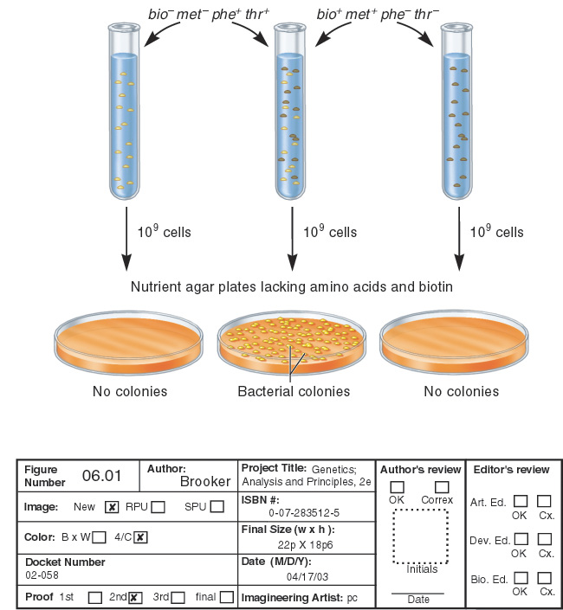
Discovery of generalized transduction
Used S. typhimurium (2 strains with opposite genotypes/phenotypes)
LA22
phe– trp– met⁺ his⁺
LA2
phe⁺ trp⁺ met– his–
Genotypes of surviving bacteria must be
phe⁺ trp⁺ met⁺ his⁺
Nutrient agar plates lacking the four amino acids
Therefore, genetic material had been transferred between the two strains
~ 1 cell in 100,000
was observed to grow
BUT:

Slide 41
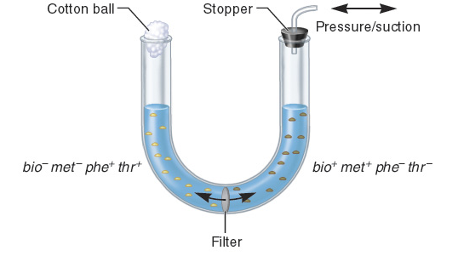
What is going on with U-tube?
LA-22
LA-2
phe– trp– met⁺ his⁺
phe⁺ trp⁺ met– his–
Nutrient agar plates lacking the four amino acids
Colonies
No colonies
Genotypes of surviving bacteria must be phe⁺ trp⁺ met⁺ his⁺

Slide 42
Prophages
Something (prophages) are getting through filter
LA2 strain had prophage- could transfer the DNA to LA22
Prophage switched to lytic cycle- brought over phe⁺ trp⁺ DNA

Slide 43
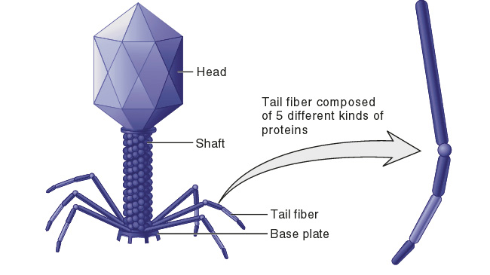
Structure of the viral particle
Contains the genetic material
Used for attachment to the bacterial surface
Copyright ©The McGraw-Hill Companies, Inc. Permission required for reproduction or display

Slide 44
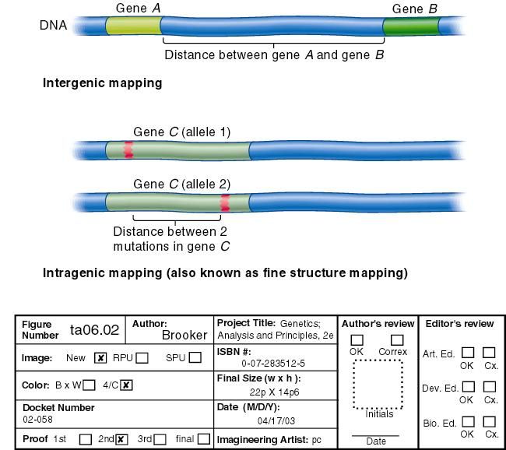
The unit of a gene
  intragenic or fine structure mapping of the T4 DNA
  The difference between intragenic and intergenic mapping is:

Slide 45
Viral phenotypes
In order to study “viral specific genes”, need to examine phenotypes these genes impart
One phenotype: plaque formation
Lytic phages lyse bacteria in regions within the lawn of organims, producing zones of clearance

Slide 46
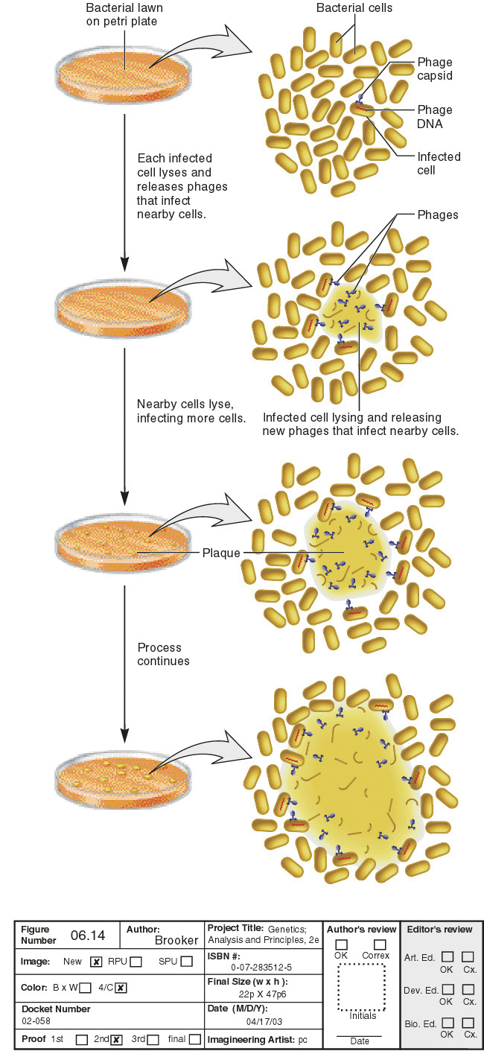
Plaque formation

